Slide 1
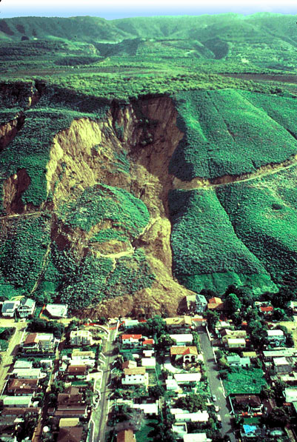
Chapter 10 Weathering, Karst Landscapes, and Mass Movement

Slide 2
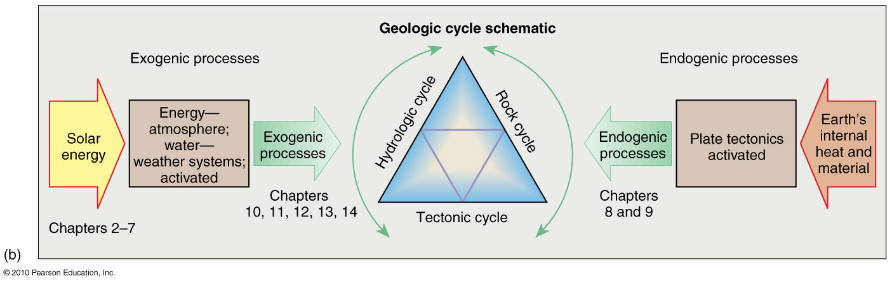
Exogenic/Endogenic Systems
Exogenic system – external processes that set air, water (streams & waves),
and ice into motion powered by solar energy. This fluid part of Earth’s
environment works toward lowering the relief.
Exogenic system – internal processes that builds and creates initial
landscapes

Slide 3
What is weathering?
Have you noticed highways in mountainous in cold climates that appear rough and broken? Roads that experience freezing weather seem to pop-up in chunks each winter? Or, maybe you saw older marble structures, such as tombstones, etched and dissolved by rainwater? Similar physical and chemical weathering processes are important to the overall reduction of the landscape and the release of essential minerals from bedrock. A simple examination of soil gives evidence of weathered mineral grains from many diverse sources.

Slide 4
Geomorphology and it’s relationship to Physical Geography
Geomorphology is a science that analyzes and describes the origin, evolution, form, and spatial distribution of landforms. It is an important aspect of the study of physical geography and the understanding of the spatial-physical aspects of landforms.
An interesting example of geomorphology is the Grand Canyon of Arizona: the erosional processes that reduce a landscape like the Grand Canyon are balanced against the resistance of the materials that make up the landscape. Weathering and erosional forces naturally oscillate, especially in the desert, with high rainfall variability coming in episodic thunderstorms. Each rainfall event at the Grand Canyon operates on available slopes and cliffs. The river receives materials and discharges its flow of water and sediment load. The variation in rock resistance is responsible for the cliffs and slopes in the rock: more resistant rock cliffs, less resistant rock slopes.

Slide 5
Weathering
Landmass Denudation
Geomorphology – the study of landforms: their origin, evolution, form and spatial distribution
Denudation: a general term referring to all processes that course reduction or rearrangement of landforms. The principal denudation processes affecting surface materials include:
weathering
mass movement
erosion
transportation
deposition

Slide 6
Weathering
Weathering is greatly influenced by the character of the bedrock: hard or soft, soluble or insoluble, broken or unbroken. The differing resistance of rock, coupled with these variations in the intensity of weathering, result in differential weathering.
Interactions between the structural elements of the land and denudation processes are complex, and represent a constant struggle between internal and external processes. An important question to ask is whether or not this dynamic interplay is progressive, evolving and building landforms in an orderly manner through stages? Do landscapes initially form and subsequently age in graceful stages until they are flat? Or does the interplay of forces fluctuate back and forth across a never achieved steady-state equilibrium? The debates in geomorphology are fueled by the fact that landscapes evolve on a much longer time span than does a human life, or a research grant, or thesis project, or the edition of a textbook. Modern geomorphology has moved away from simple descriptive classifications.

Slide 7
Principal considerations in the dynamic equilibrium model
Dynamic Equilibrium Approach to Landforms:
The balance between tectonic uplift and reduction by weathering and erosion, between resistance of rocks and the continuous attack of weathering and erosion
Landscapes evidence ongoing adaptation to rock structure, climate, local relief, and elevation. A dynamic equilibrium demonstrates a trend over time. Endogenic events (such as earthquakes and volcanic eruptions), or exogenic events (such as heavy rainfall or forest fire), may provide new sets of relationships for the landscape.

Slide 8
Geomorphic Threshold (change point)
Geomorphic threshold: the point at which there is enough energy to overcome the resistance against movement. Landforms follow a pattern of sequence:
equilibrium stability
destabilizing event
a period of adjustment
development of a new and different condition of equilibrium stability

Slide 9
Conditions on a hillslope that is right at the geomorphic threshold
As changing conditions provide new sets of relationships for the landscape, the system eventually arrives at a geomorphic threshold, or that point at which the system breaks through to a new set of equilibrium relationships and rapidly realigns landscape materials accordingly. Slopes, as parts of landscapes, are open systems and seek an angle of equilibrium among the forces described here. Conflicting forces work together on slopes to establish an optimum compromise incline that balances these forces. A geomorphic threshold (change point) is reached when any of the conditions in the balance is altered. Many factors could alter the hillside's equilibrium, such as an earthquake, or the building of a house or dam (adding mass). All the forces on the slope then compensate by adjusting to a new dynamic equilibrium.

Slide 10
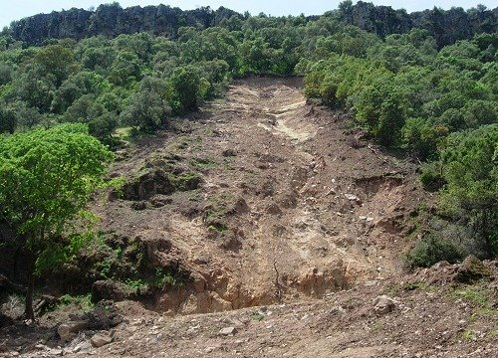
A slope in disequilibrium

Slide 11
Geomorphic threshold on slopes
Slopes seek an angle of equilibrium among the forces mentioned. In other words, slopes exhibit maximum inclines that balance conflicting forces. A geomorphic threshold (change point) is reached if one of the conditions in the balance alters. When this occurs all the forces on the slope compensate by adjusting to a new dynamic equilibrium. A slope is an open system responding to variable inputs and producing variable outputs

Slide 12
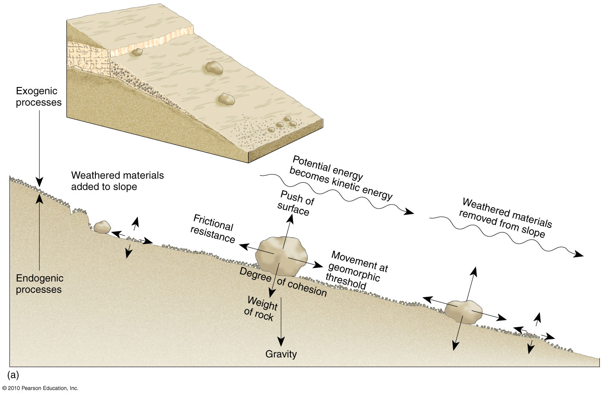
Slope Mechanics and Form
Angle of equilibrium among the
geomorphic forces
Figure 10.3
Christopherson, Elemental Geosystems, Sixth Edition
Copyright © 2010 Pearson Education, Inc.

Slide 13
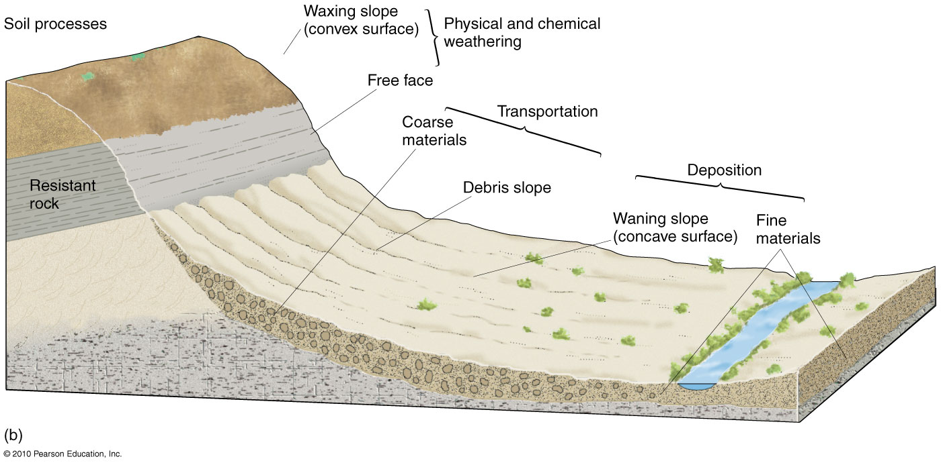
Slope Mechanics and Form
The relationship between rates of weathering and breakup of slope materials, coupled with the rates of mass movement and material erosion, shapes slopes. A slope is stable if its strength exceeds these denudation processes and unstable if materials are weaker than these processes.
Figure 10.3
Christopherson, Elemental Geosystems, Sixth Edition
Copyright © 2010 Pearson Education, Inc.

Slide 14
Weathering Processes
Factors Influencing Weathering Processes
Character of the bedrock – hard or soft, soluble or insoluble, broken or unbroken, joints
Climatic elements: precipitation, temperature, freeze-thaw cycles
Geographic orientation of a slope
vegetation
Physical Weathering Processes - breakdown of rock by physical forces
Frost action
Salt-crystal growth (salt weathering)
Pressure-release jointing
Chemical Weathering Processes – breakdown of rock by chemical reactions
Hydration and hydrolysis
Oxidation
Dissolution of carbonates

Slide 15
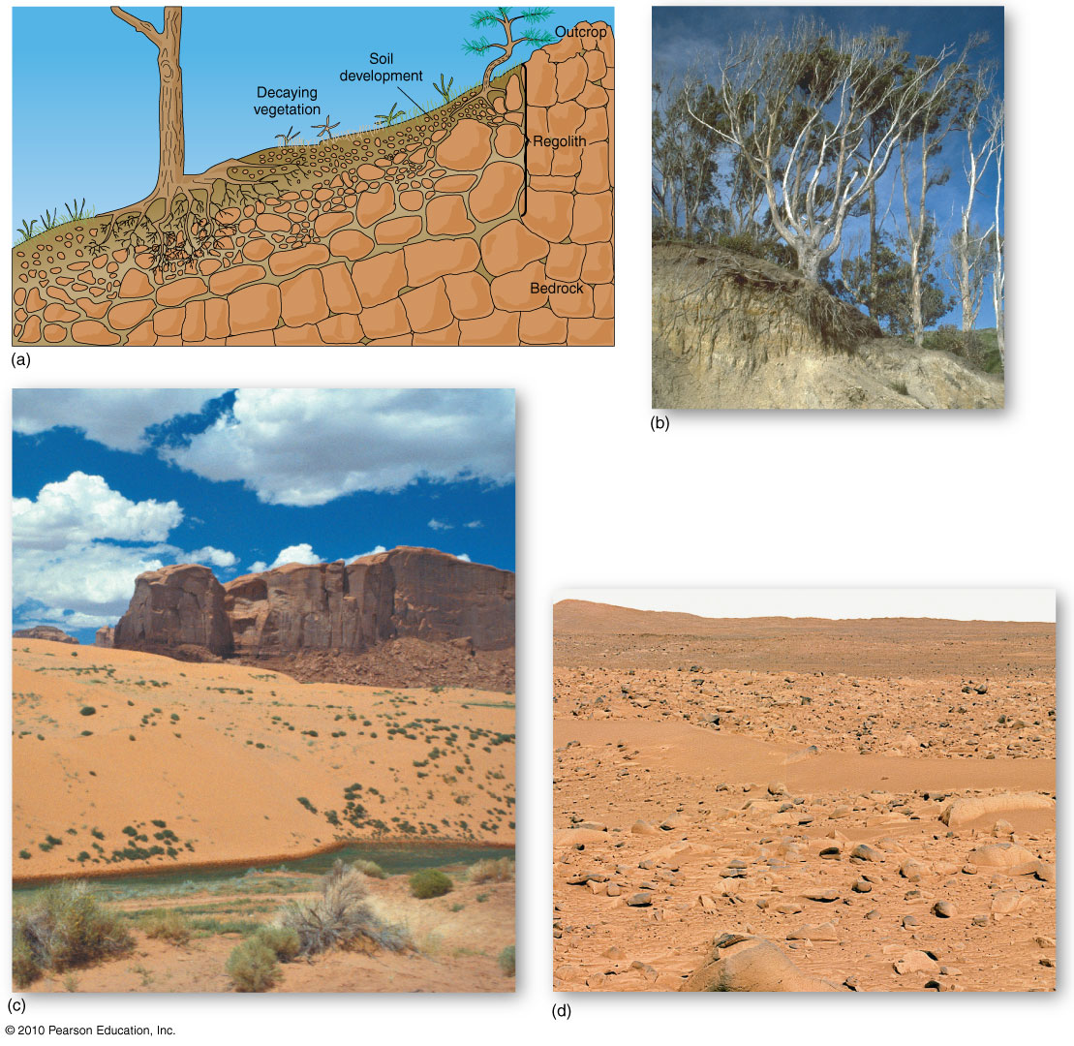
Regolith, Soil, and Parent Materials
Regolith – broken-up rock material at the
Earth’s surface
Figure 10.4
Christopherson, Elemental Geosystems, Sixth Edition
Copyright © 2010 Pearson Education, Inc.

Slide 16
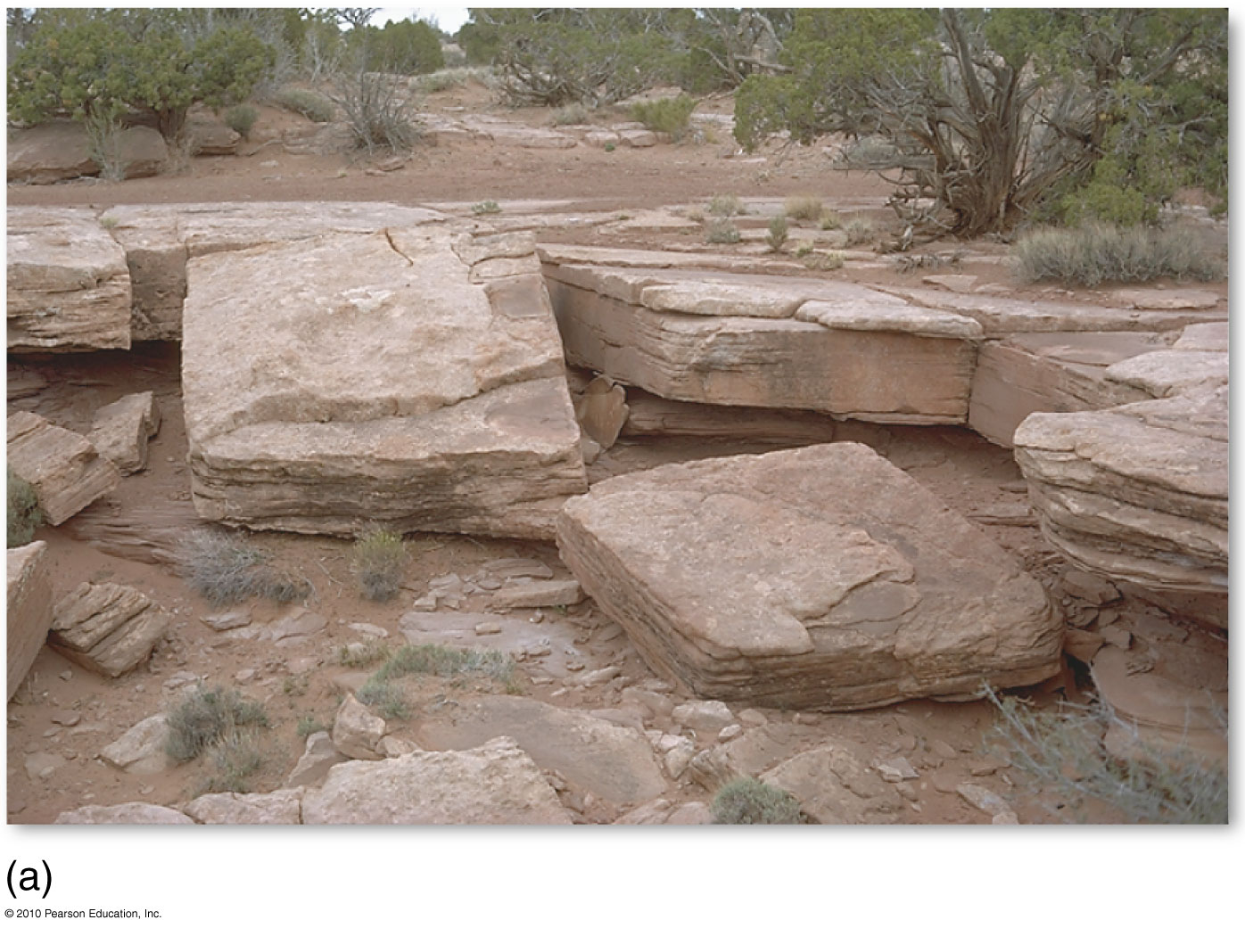
Physical Weathering
Figure 10.6a
Christopherson, Elemental Geosystems, Sixth Edition
Copyright © 2010 Pearson Education, Inc.

Slide 17
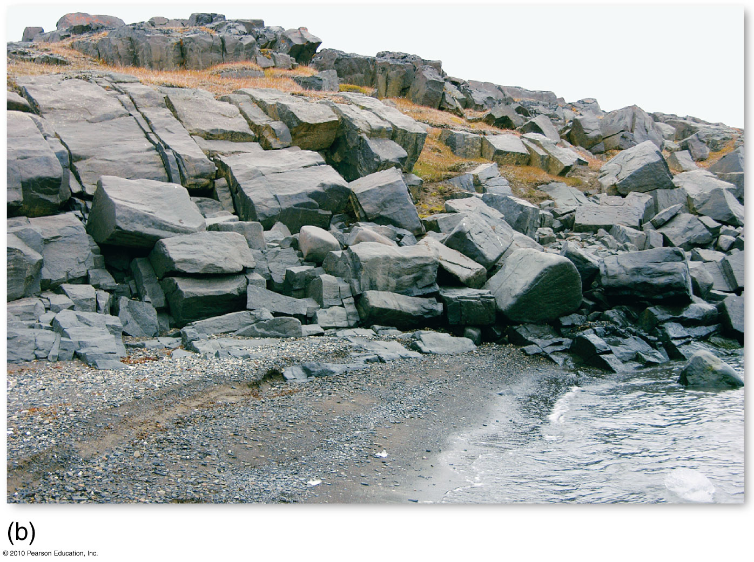
Joint-Block Separation
Figure 10.6b
Christopherson, Elemental Geosystems, Sixth Edition
Copyright © 2010 Pearson Education, Inc.

Slide 18
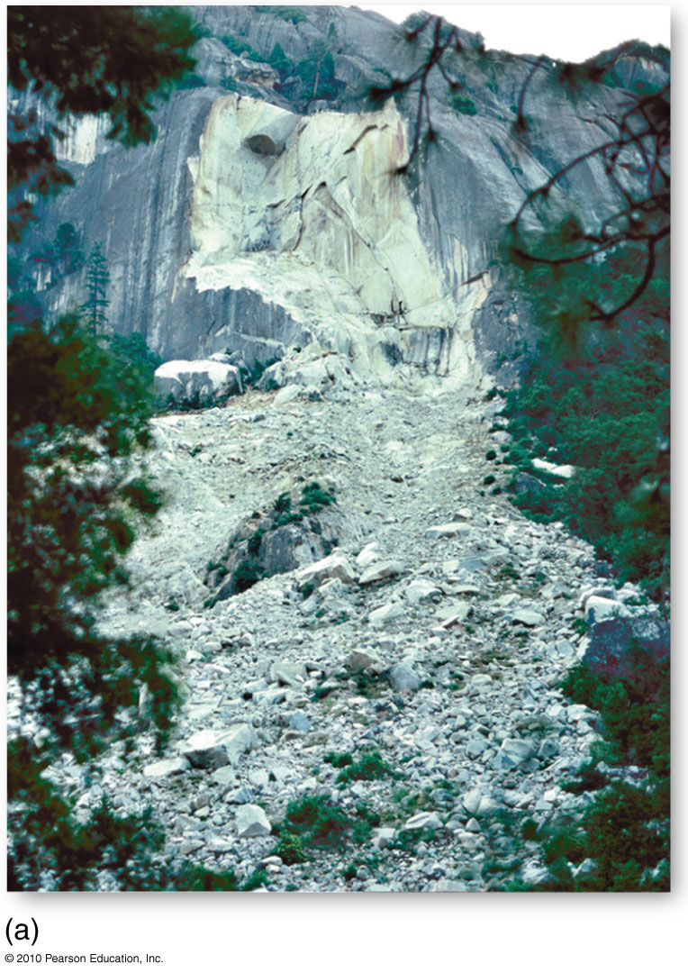
Rockfall
Figure 10.7
Christopherson, Elemental Geosystems, Sixth Edition
Copyright © 2010 Pearson Education, Inc.

Slide 19
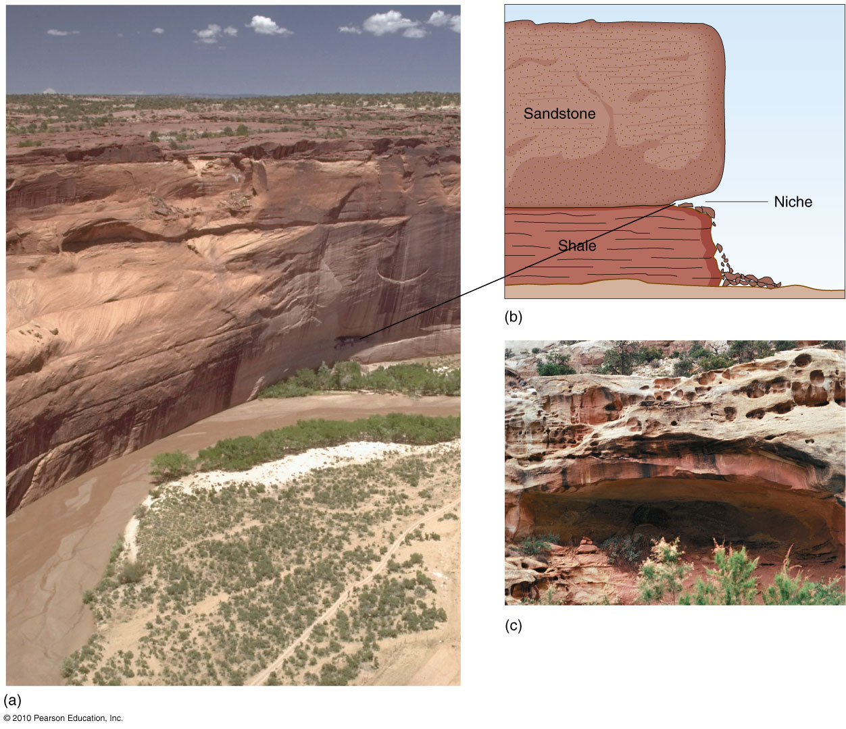
Physical Weathering in Sandstone
Figure 10.8
Christopherson, Elemental Geosystems, Sixth Edition
Copyright © 2010 Pearson Education, Inc.

Slide 20
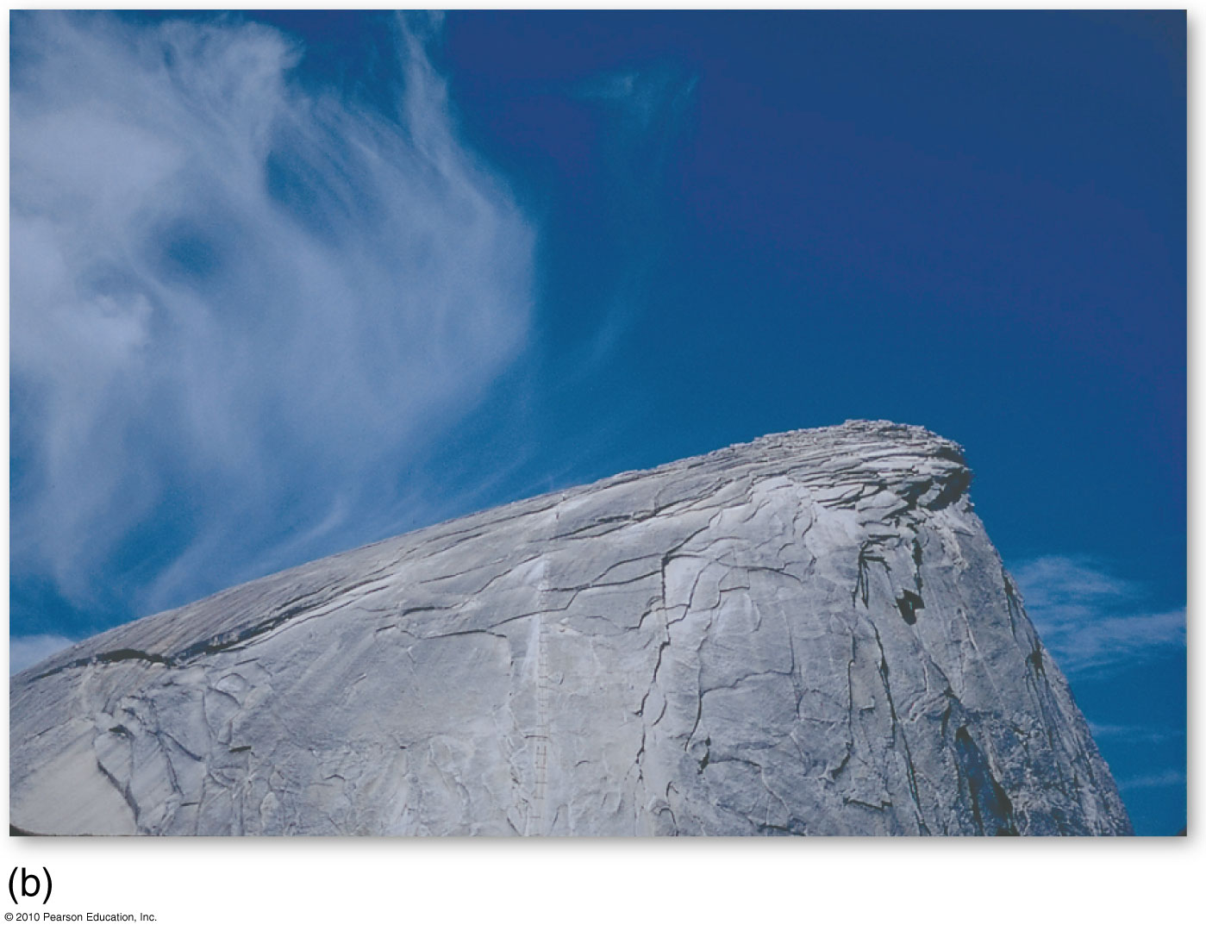
Exfoliation in Granite
Pressure release jointing
Exfoliation dome
Figure 10.9b
Christopherson, Elemental Geosystems, Sixth Edition
Copyright © 2010 Pearson Education, Inc.

Slide 21
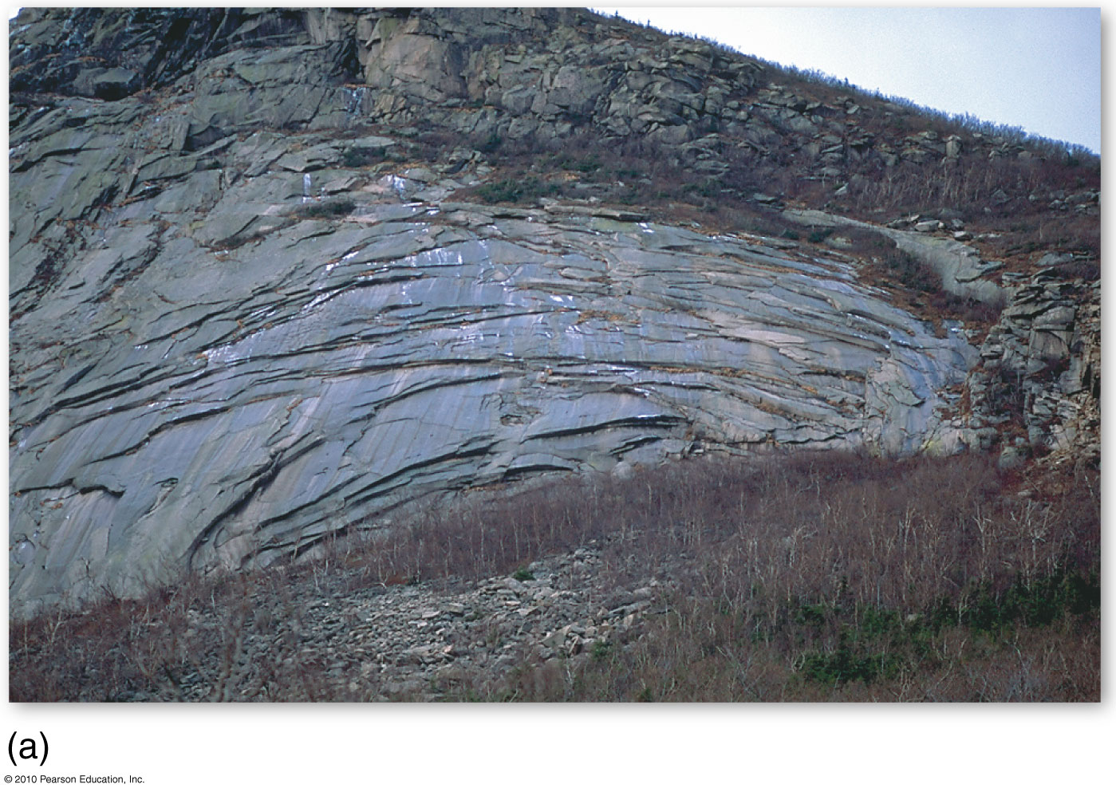
Exfoliation in Granite
Figure 10.9a
Christopherson, Elemental Geosystems, Sixth Edition
Copyright © 2010 Pearson Education, Inc.

Slide 22
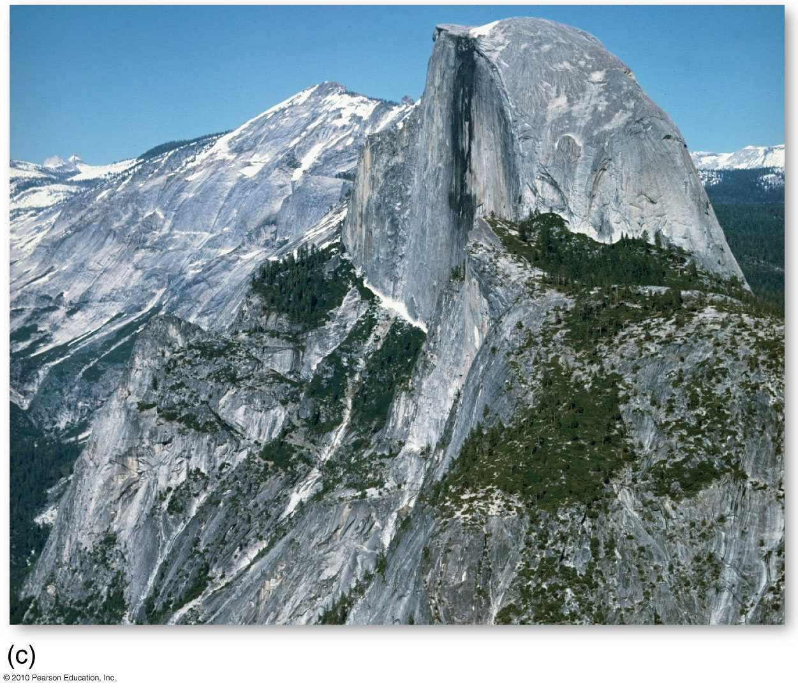
Exfoliation in Granite
Figure 10.9c
Christopherson, Elemental Geosystems, Sixth Edition
Copyright © 2010 Pearson Education, Inc.

Slide 23
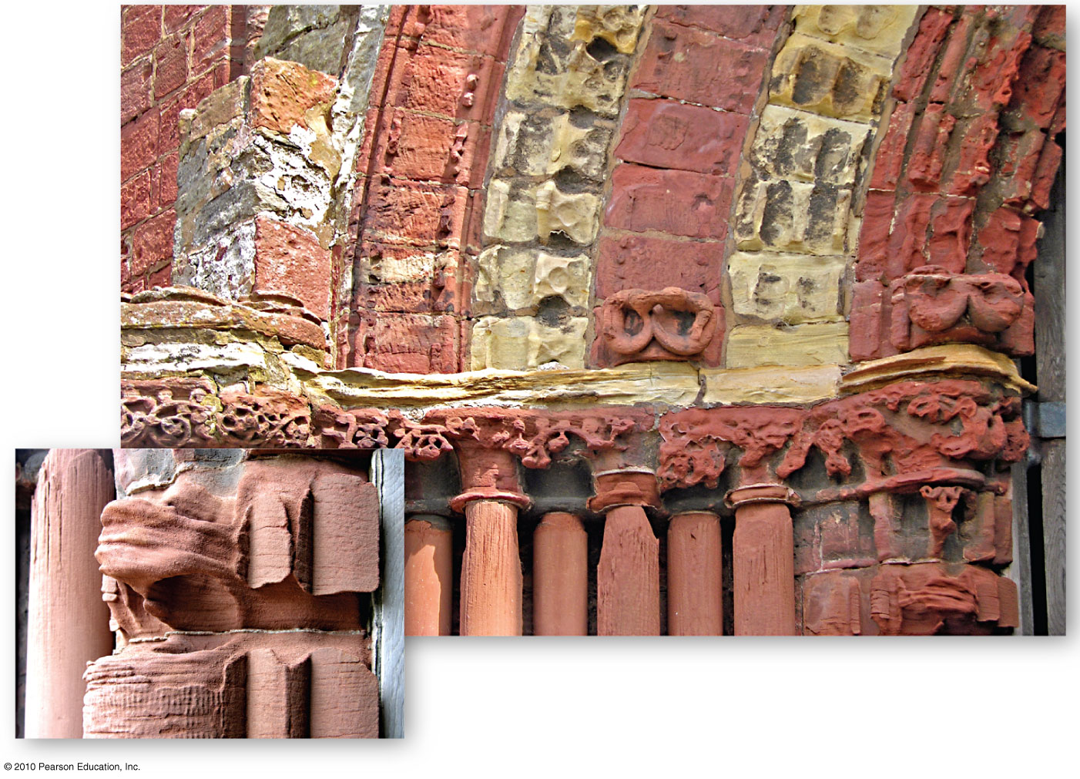
Chemical Weathering
Figure 10.10
Christopherson, Elemental Geosystems, Sixth Edition
Copyright © 2010 Pearson Education, Inc.

Slide 24
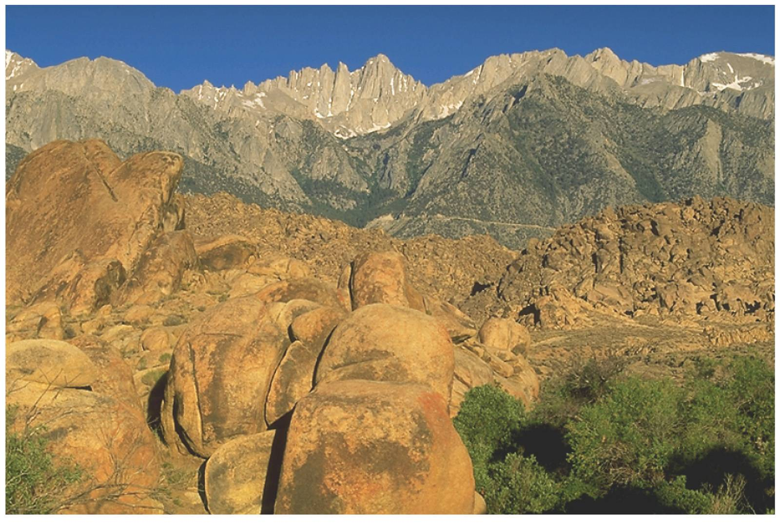
Chemical Weathering
Spheroidal weathering
Christopherson, Elemental Geosystems, Sixth Edition
Copyright © 2010 Pearson Education, Inc.

Slide 25
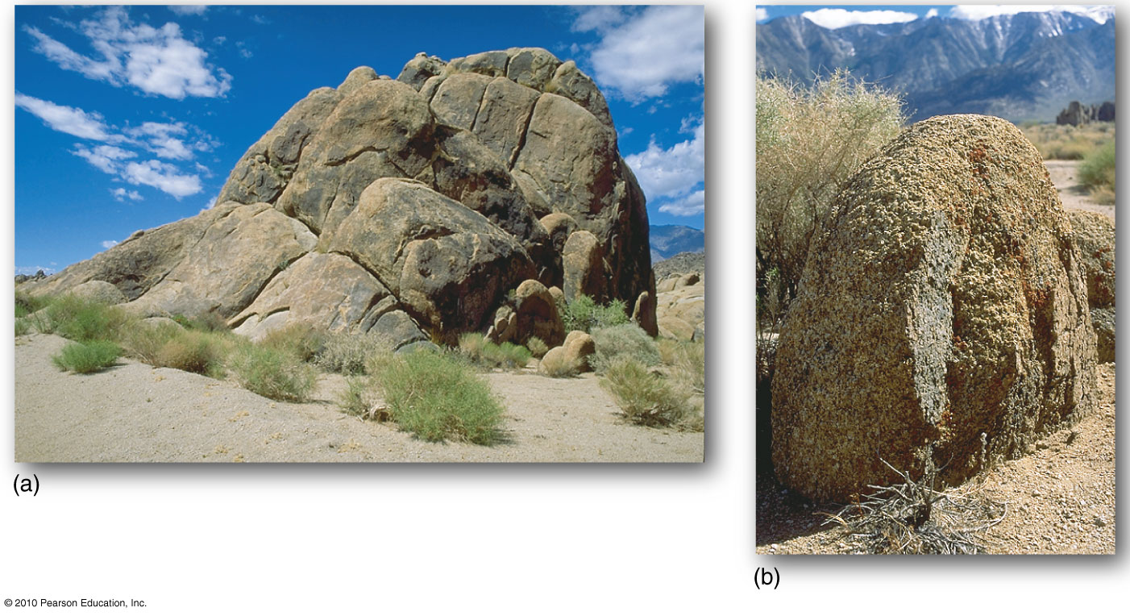
Spheroidal Weathering
Figure 10.11
Christopherson, Elemental Geosystems, Sixth Edition
Copyright © 2010 Pearson Education, Inc.

Slide 26
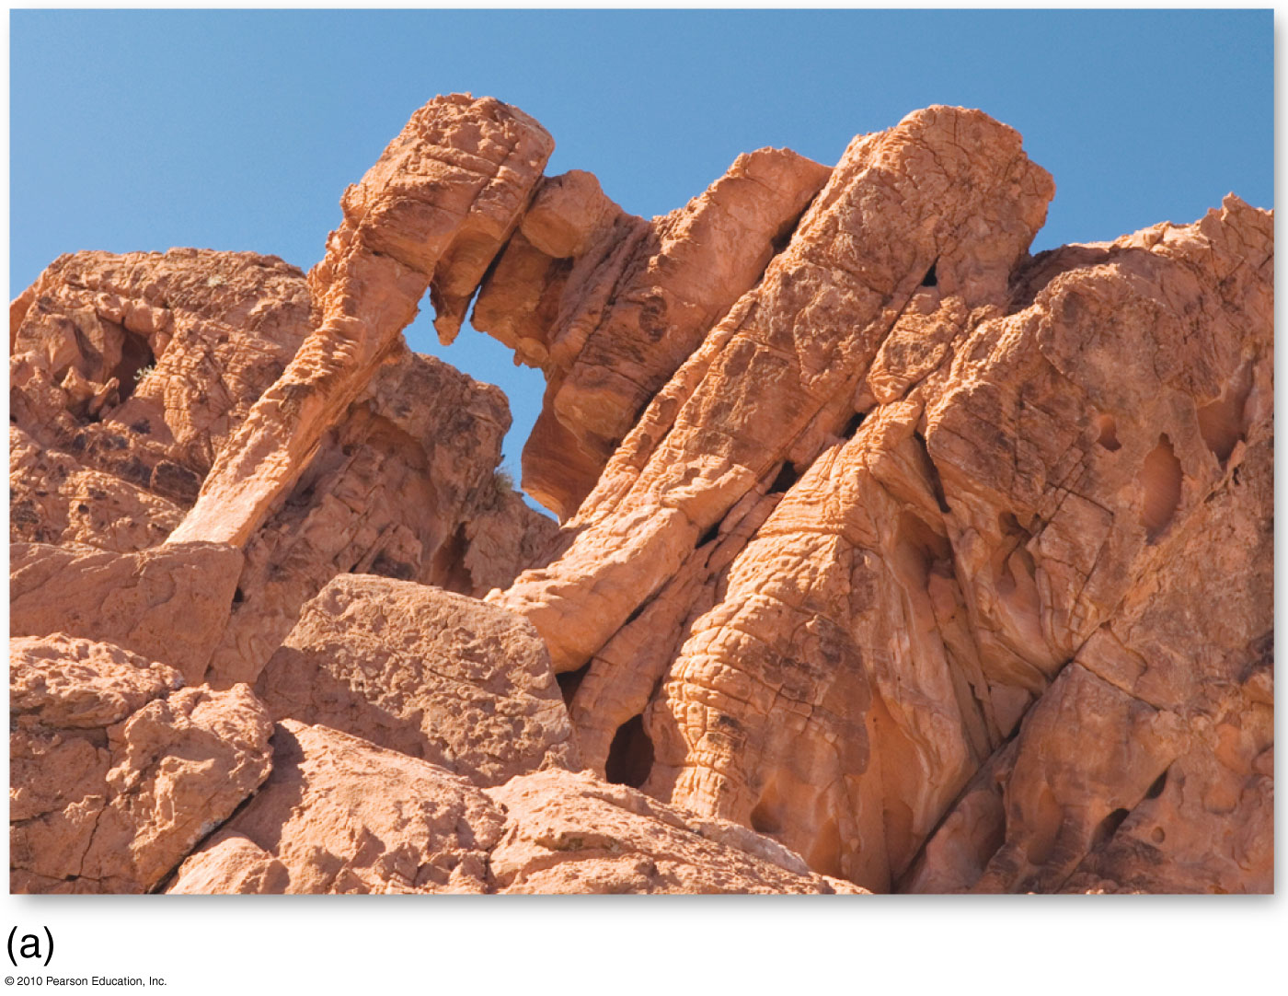
Oxidation in Rock
Figure 10.12
Christopherson, Elemental Geosystems, Sixth Edition
Copyright © 2010 Pearson Education, Inc.

Slide 27
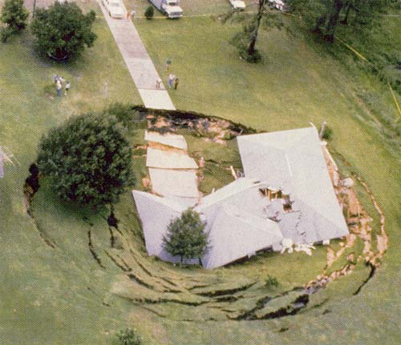
Dissolution of Carbonates

Slide 28
Karst Topography and Landscapes
Formation of Karst
Limestone formation must contain 80% or more calcium carbonate
Complex patterns of joints needed for water to form routes to subsurface drainage channels
Must be an aerated zone between the ground surface and water table
Vegetation cover is required for the supply of organic acids that enhance the dissolution process

Slide 29
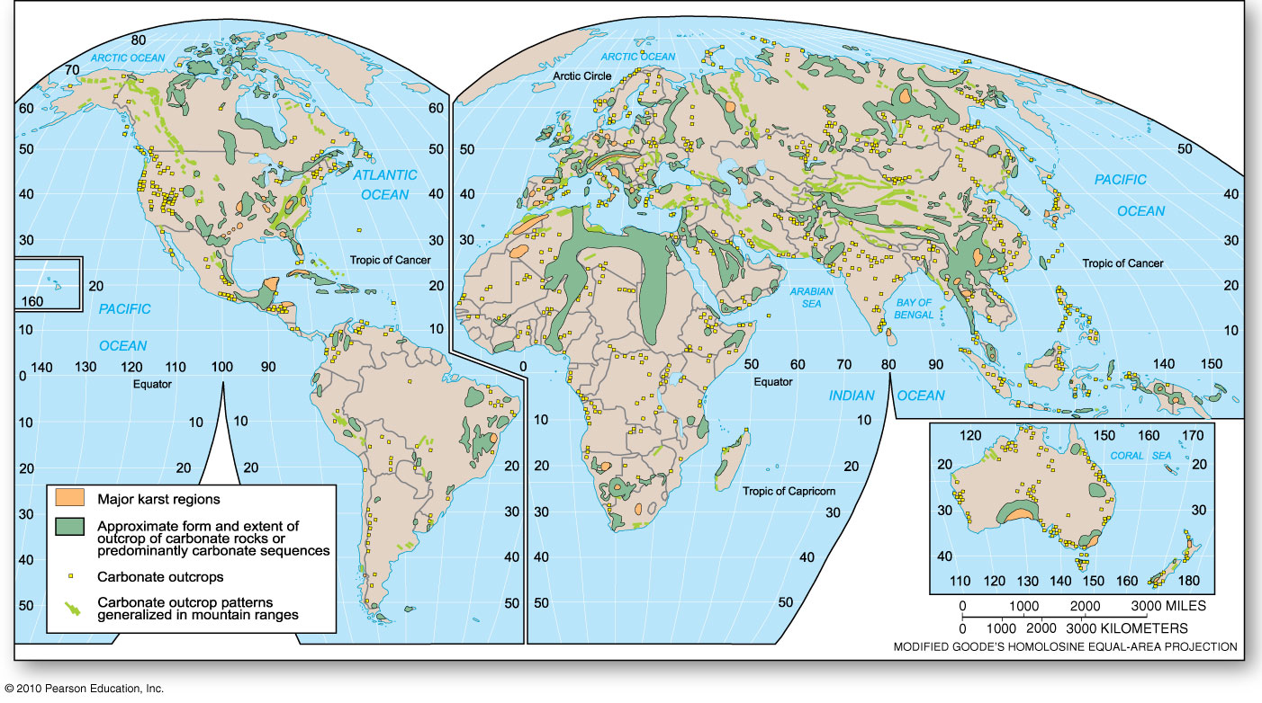
Karst and Limestone Regions
Figure 10.14

Slide 30
Karst Topography and Landscapes
Lands Covered with Sinkholes
Weathering of limestone landscapes creates many sinkholes forming circular depressions
Collapse sinkhole e.g. Florida
Karst valley – elongated depression up to several km long
Complex landscape in which sinkhole intersect – cockpit karst

Slide 31
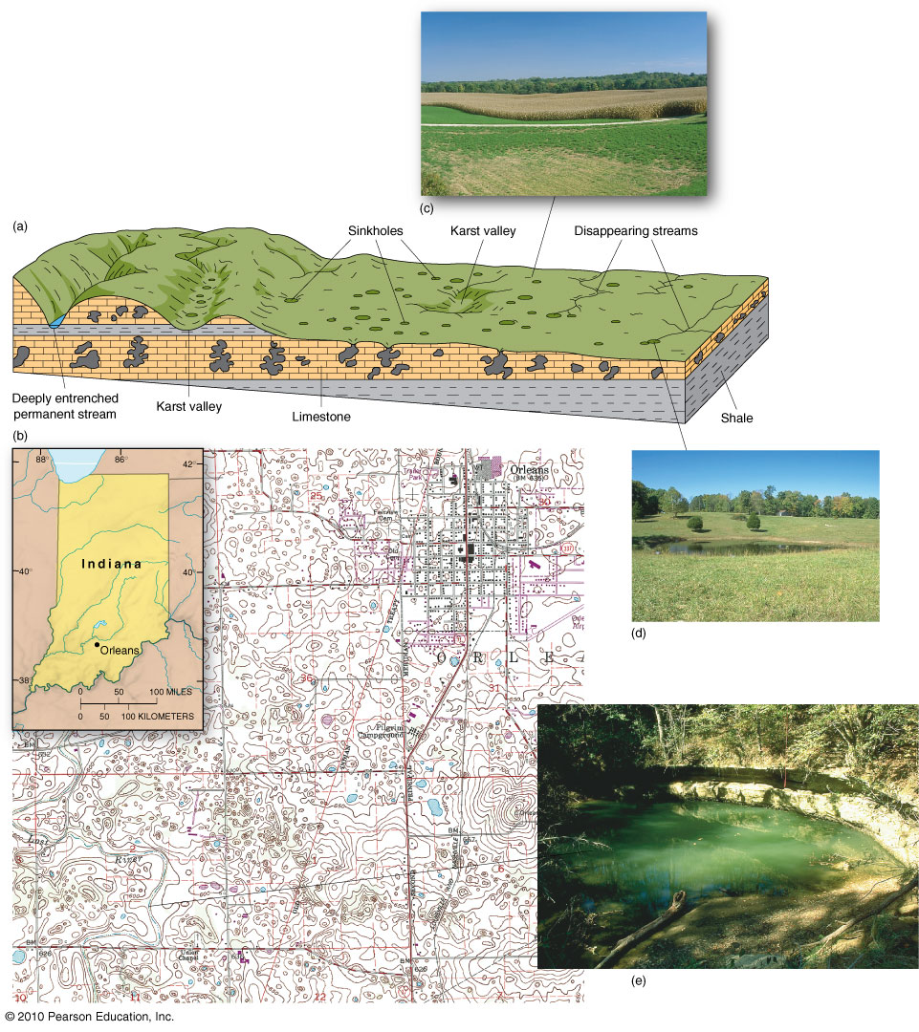
Karst Topography
Figure 10.15
Christopherson, Elemental Geosystems, Sixth Edition
Copyright © 2010 Pearson Education, Inc.

Slide 32
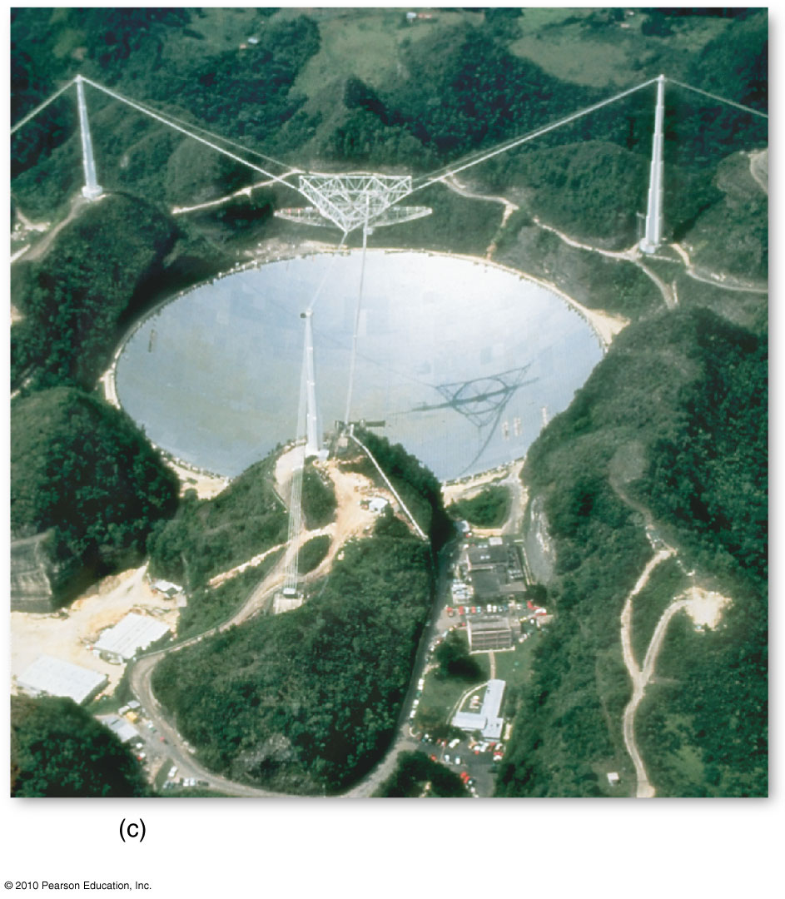
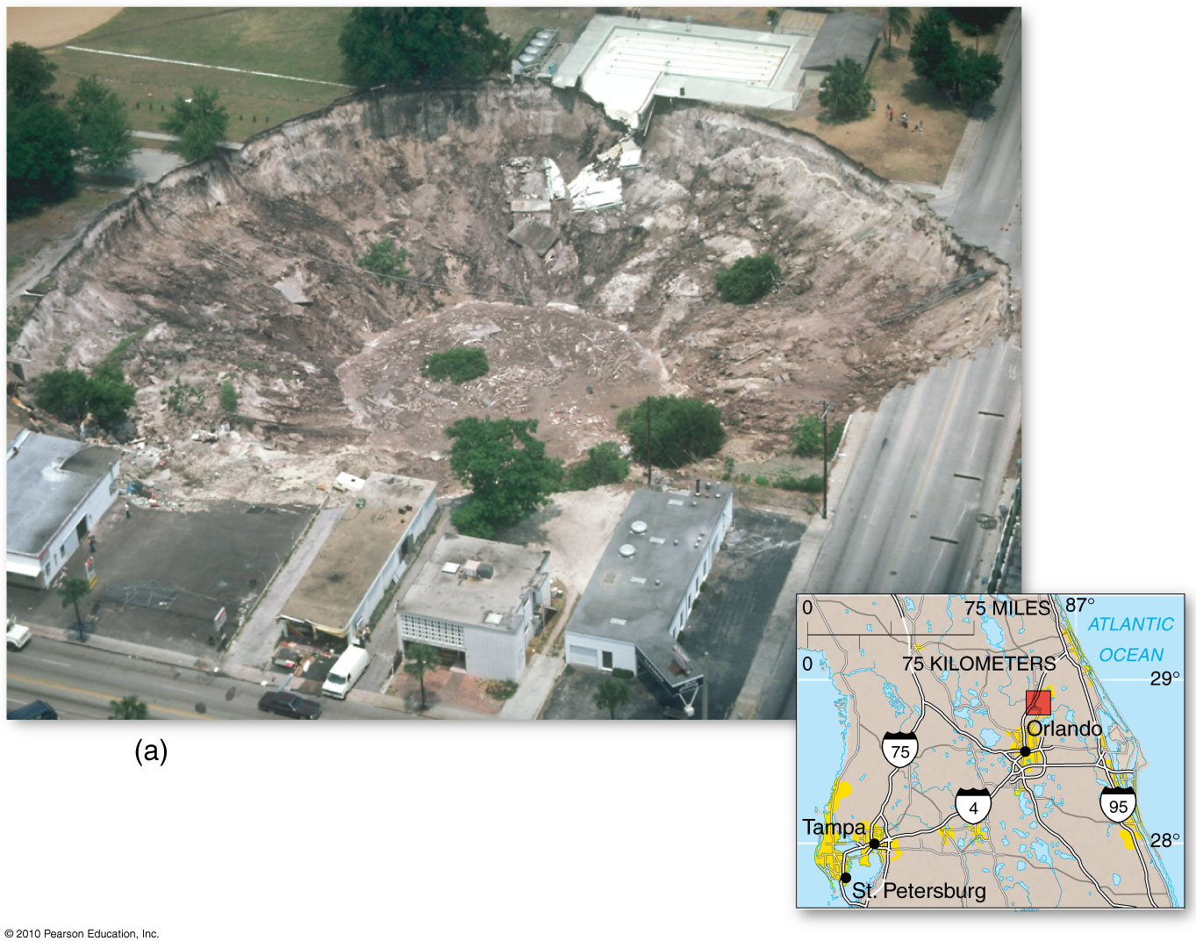
Sinkholes
Figure 10.16
Christopherson, Elemental Geosystems, Sixth Edition
Copyright © 2010 Pearson Education, Inc.

Slide 33
Karst Topography and Landscapes
Caves and Caverns: subterranean world
Carlsbad Cavern in New Mexico – limestone deposited 200 million years ago
Dripstones
Stalactites
Stalagmites
column
Speleology – study of caves

Slide 34
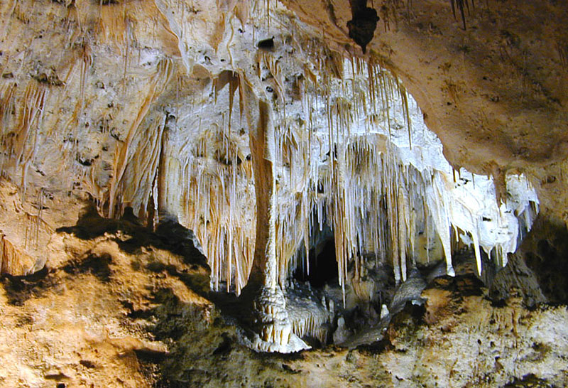
Carlsbad Cavern

Slide 35
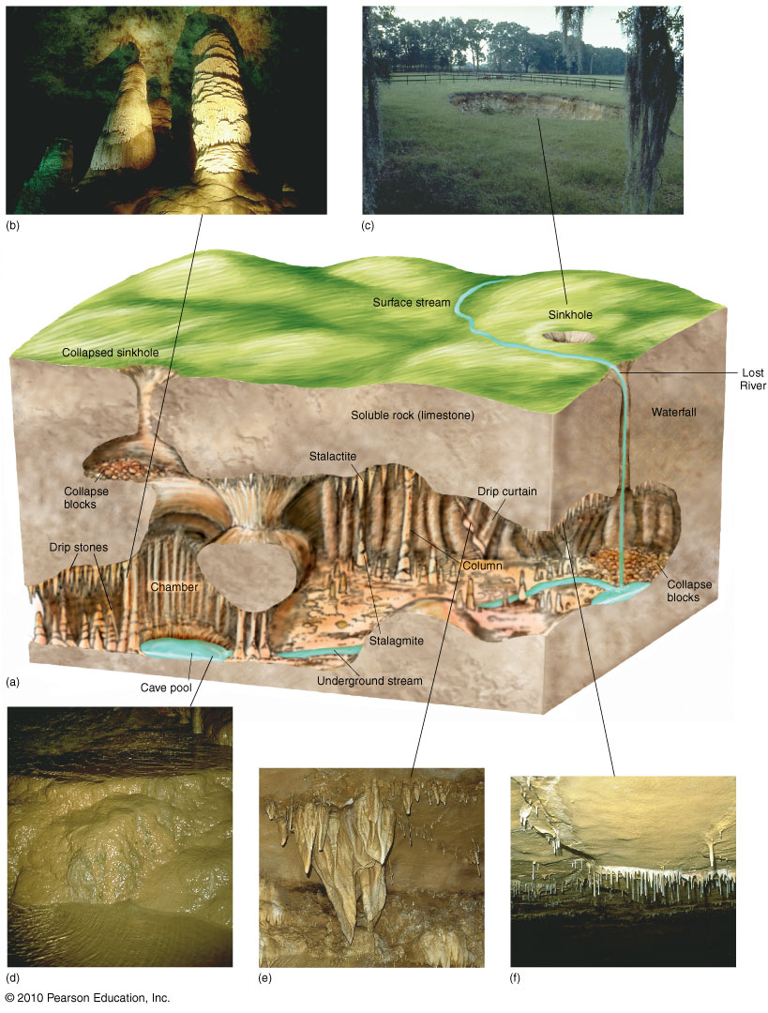
Cavern Features
Figure 10.17
Christopherson, Elemental Geosystems, Sixth Edition
Copyright © 2010 Pearson Education, Inc.

Slide 36
Mass-Movement Processes
Mass-Movement Mechanics
The role of slopes
Frank Slide, Crowsnest Pass, Alberta
Classes of Mass Movements
Falls and avalanches
Landslide
Flow
Creep
Human-Induced Mass Movements

Slide 37
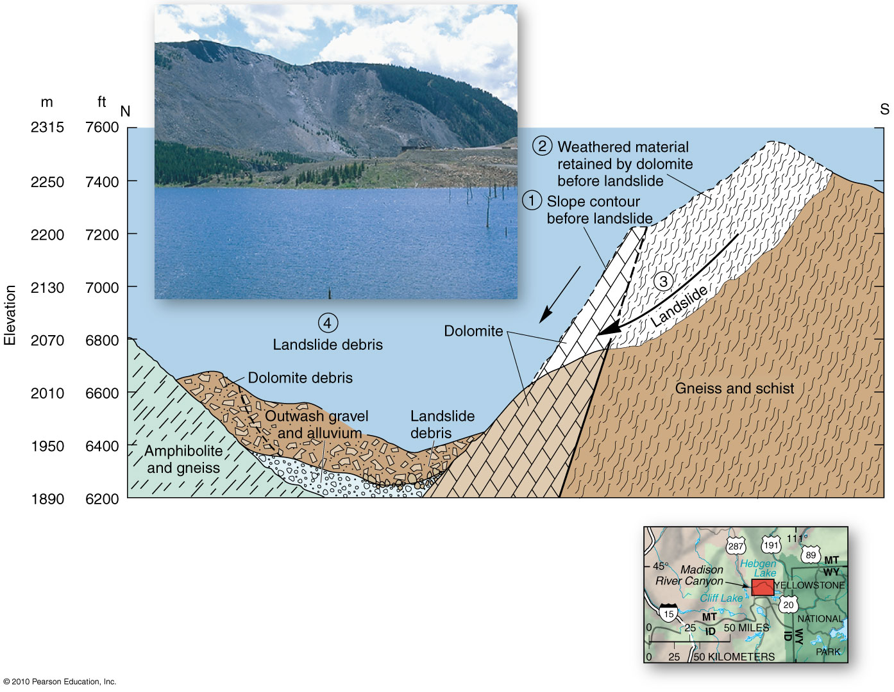
Madison River Landslide
Figure 10.18
Christopherson, Elemental Geosystems, Sixth Edition
Copyright © 2010 Pearson Education, Inc.

Slide 38
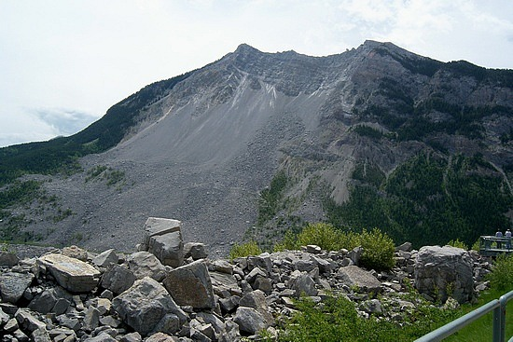
Frank Slide, Alberta

Slide 39
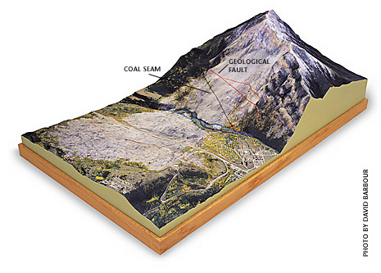

Slide 40
Classes of Mass Movements
In any mass-movement, gravity pulls on a mass until the critical shear-failure point is reached – geomorphic threshold
4 classes of mass movement
Fall
Slide
Flow
creep

Slide 41
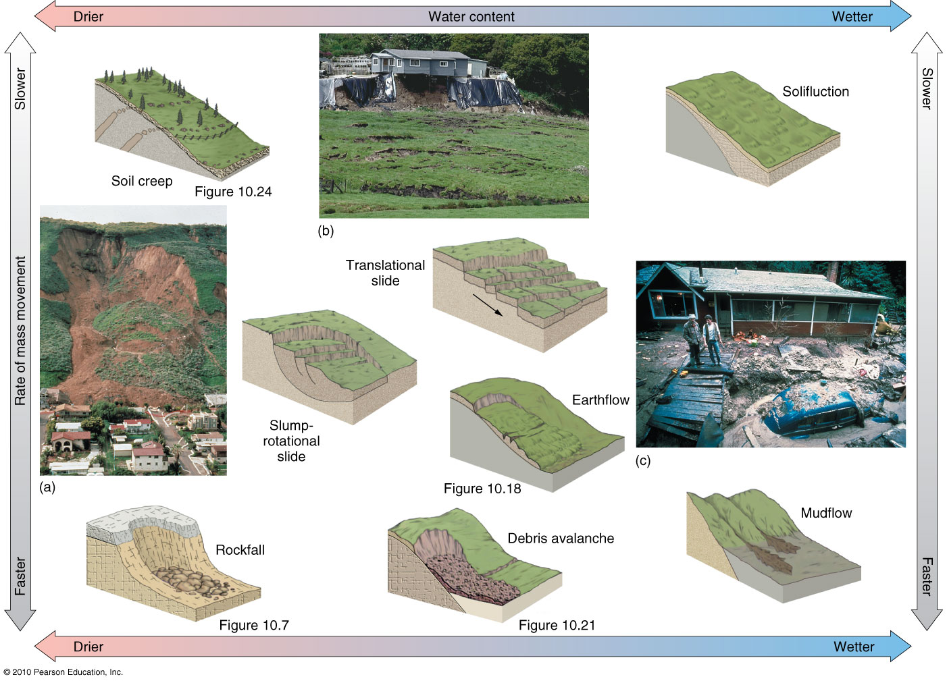
Mass-Movement Classes
Figure 10.19
Christopherson, Elemental Geosystems, Sixth Edition
Copyright © 2010 Pearson Education, Inc.

Slide 42
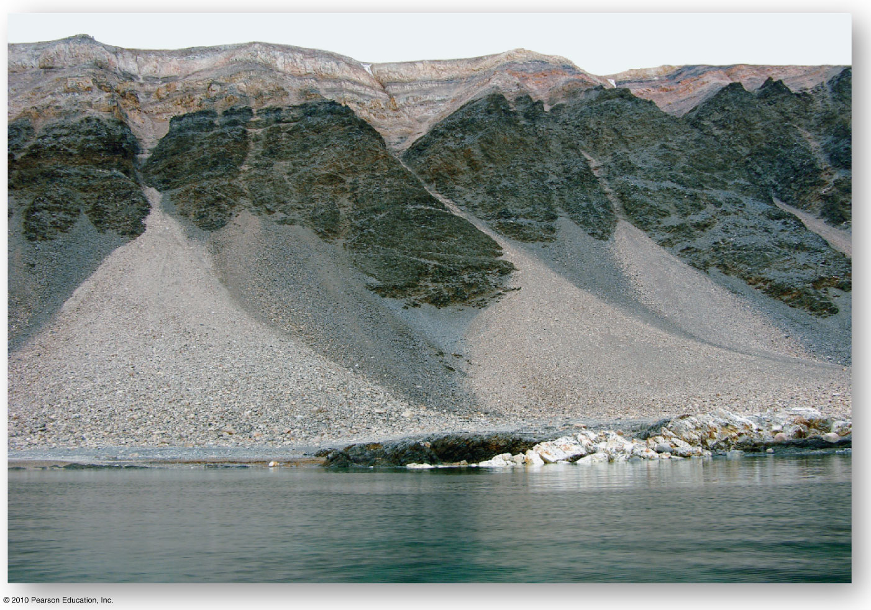
Talus Slopes
Figure 10.20
Christopherson, Elemental Geosystems, Sixth Edition
Copyright © 2010 Pearson Education, Inc.

Slide 43
Classes of Mass Movements
Falls and Avalanches
Rockfall is simply a quantity of rock that falls through the air and hits a surface
Talus slope; talus cones
Debris avalanche
A mass of falling and tumbling rock, debris and soil
Tremendous velocity differentiates a debris avalanche from a rock fall/avalanche
High speeds due to ice and water that fluidize the debris

Slide 44
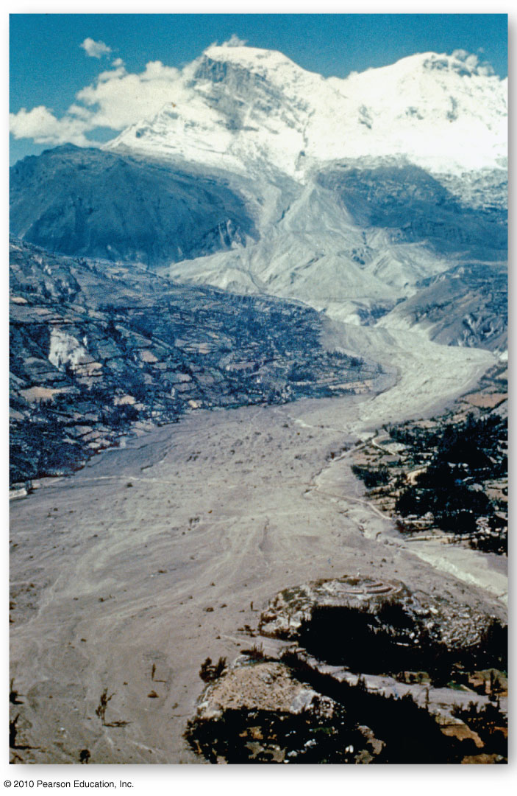
Debris Avalanche, Peru
Figure 10.21
Christopherson, Elemental Geosystems, Sixth Edition
Copyright © 2010 Pearson Education, Inc.

Slide 45
Classes of Mass Movement
Landslide
A sudden rapid movement of a cohesive mass of regolith or bedrock that is not saturated with moisture
Downward flow of gravity predominates
Slide occur in one of 2 basic forms
translational slides: movement along a flat surface parallel to the angle of the slope
rotational slides: surface material moves along a concave surface

Slide 46
Classes of Movement
Flow
Moisture content of moving material is high e.g. mudflow, earthflow
Gros Ventre landslide: due to melted snow and rain on the slope, caused the sandstone formation lying above weak shale to move downslope as a unit
Creep
Persistent mass movement of surface soil
Freeze-thaw cycle of surface soil; overall wasting of a slope

Slide 47
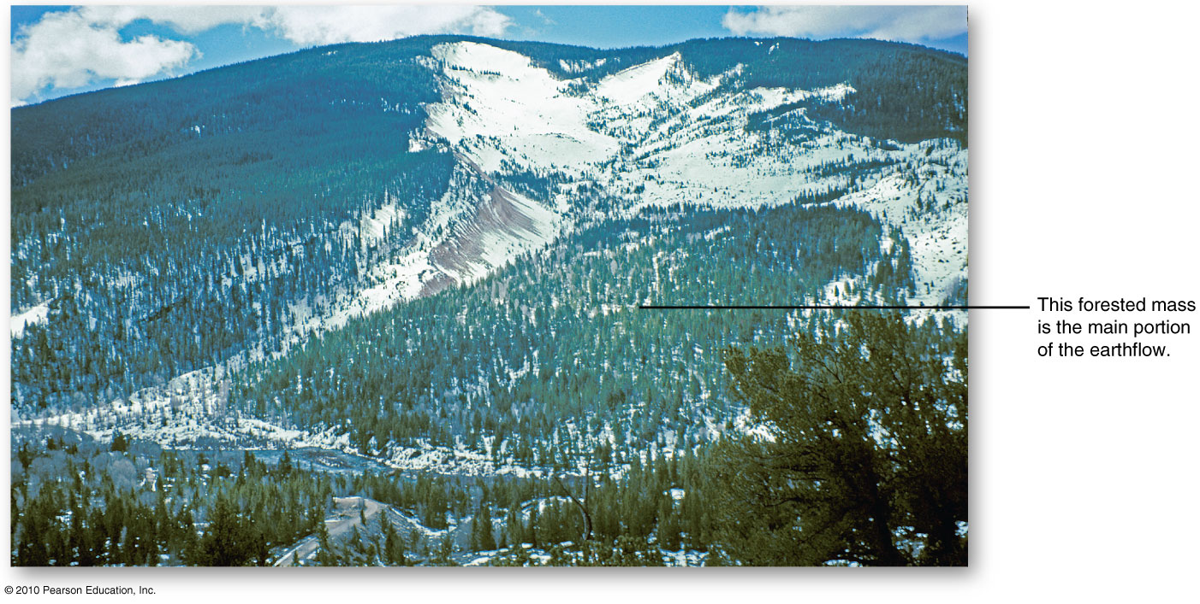
Gros Ventre Slide, Wyoming
Figure 10.23
Christopherson, Elemental Geosystems, Sixth Edition
Copyright © 2010 Pearson Education, Inc.

Slide 48
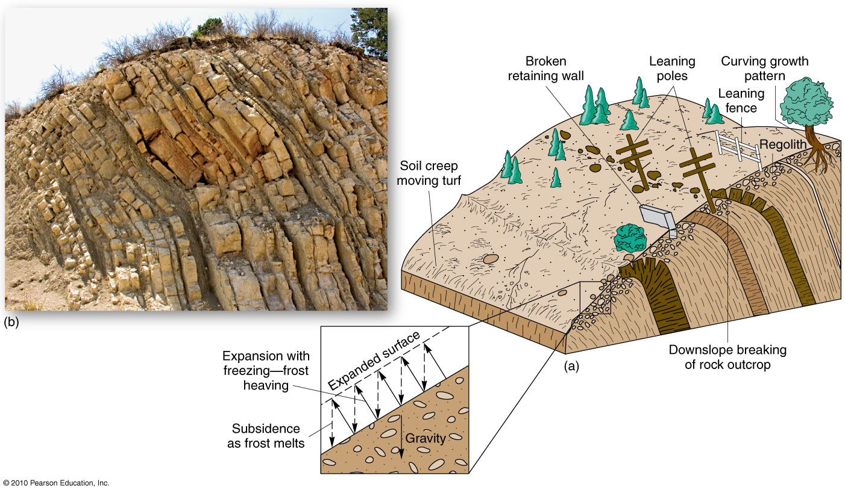
Soil Creep
Figure 10.24
Christopherson, Elemental Geosystems, Sixth Edition
Copyright © 2010 Pearson Education, Inc.

Slide 49
Human-Induced mass Movements
Highway roadcuts
Surface mining - scarification
Building of a shopping mall
Housing development
Causes newly destabilized and oversteepened surfaces are thrust into a search for a new equilibrium

Slide 50
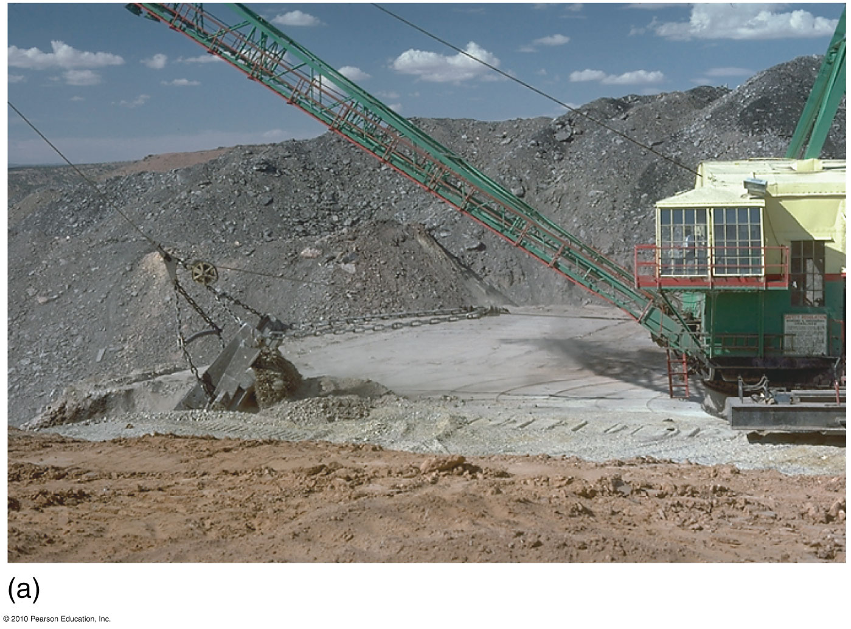
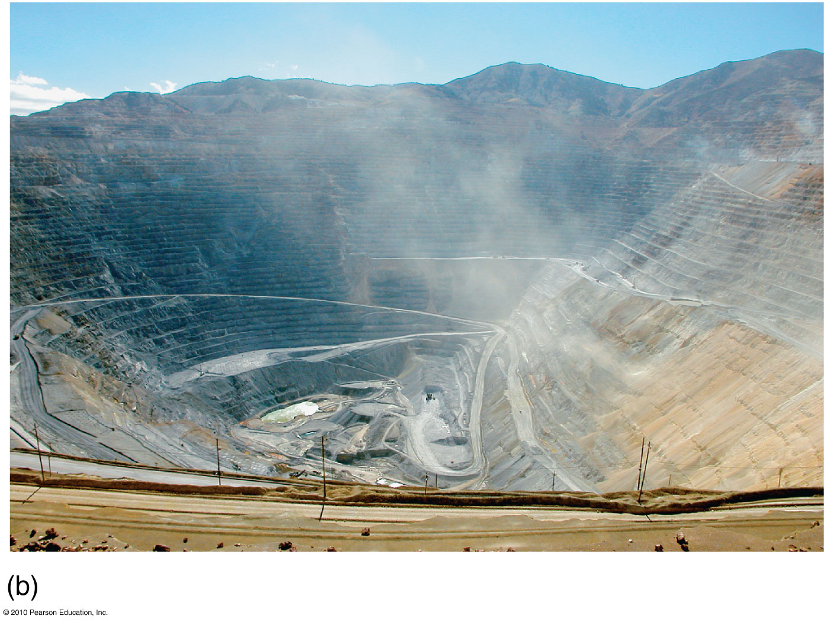
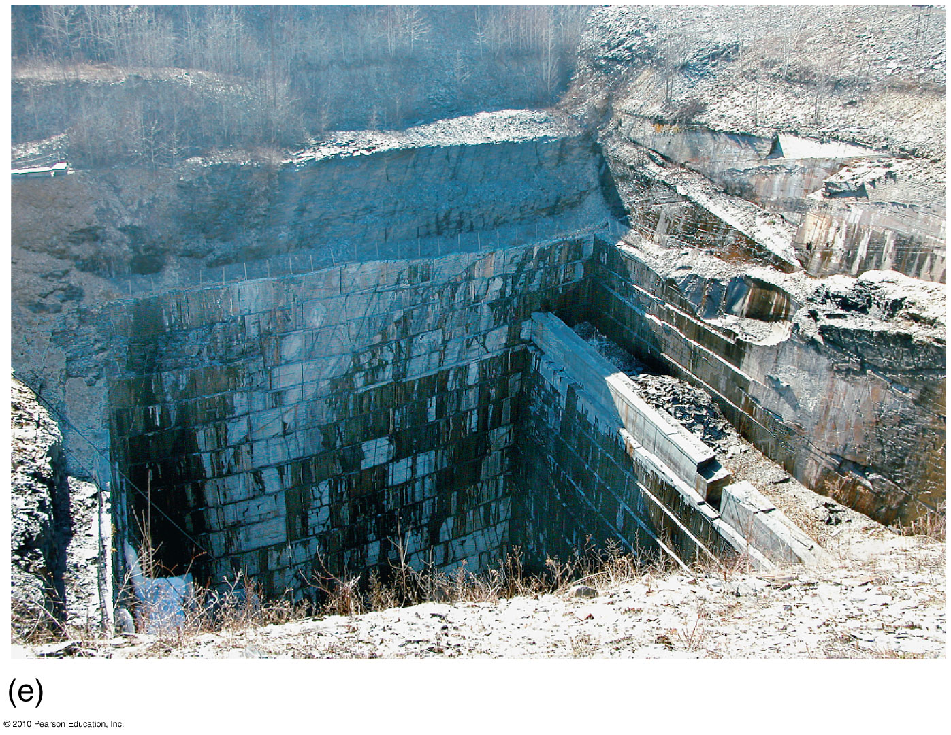
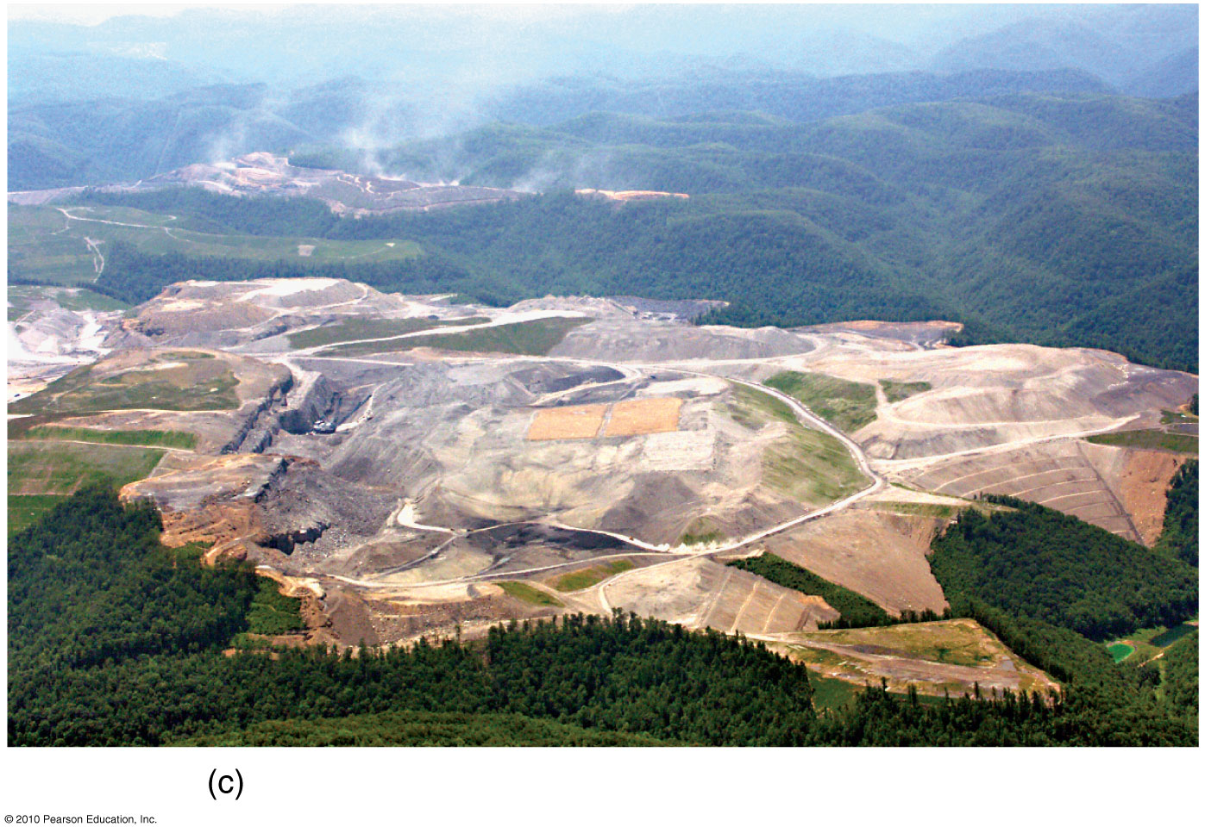
Scarification
Figure 10.25
Christopherson, Elemental Geosystems, Sixth Edition
Copyright © 2010 Pearson Education, Inc.

Slide 51
End of Lecture
Next lecture – chapter 11

